Slide 1
Computer Networks
Routing protocols

Slide 2
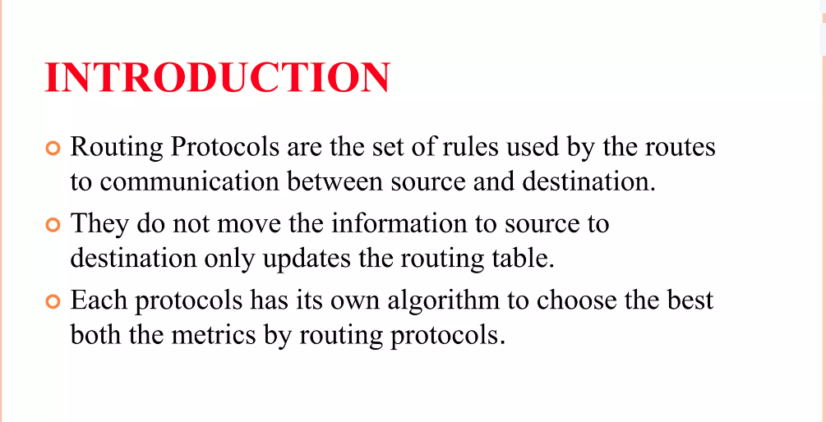
Routing protocols

Slide 3
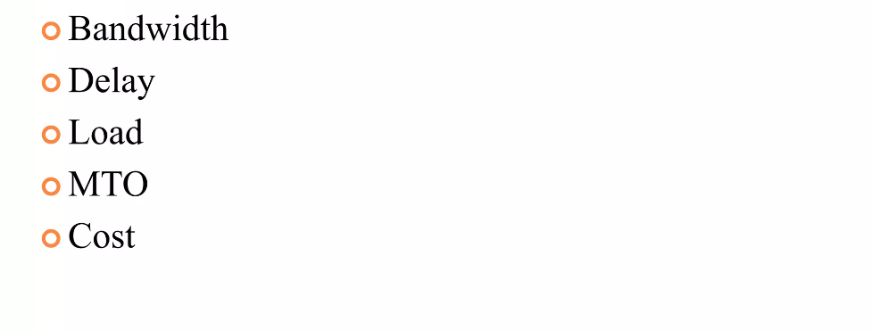
The matrices by routing protocols

Slide 4
The matrices by routing protocols
Routing protocols store the result of these matrices in routing tables:
Bandwidth:
Maximum data transfer rate across a network path
Delay:
Time it takes for data packets to travel from a source to a destination through various network nodes
Load:
Refers to the level of traffic or demand on network resources
MTO:
Refers to minimizing the additional data or processing required to direct information packets efficiently from one point to another, to enhance network performance.

Slide 5
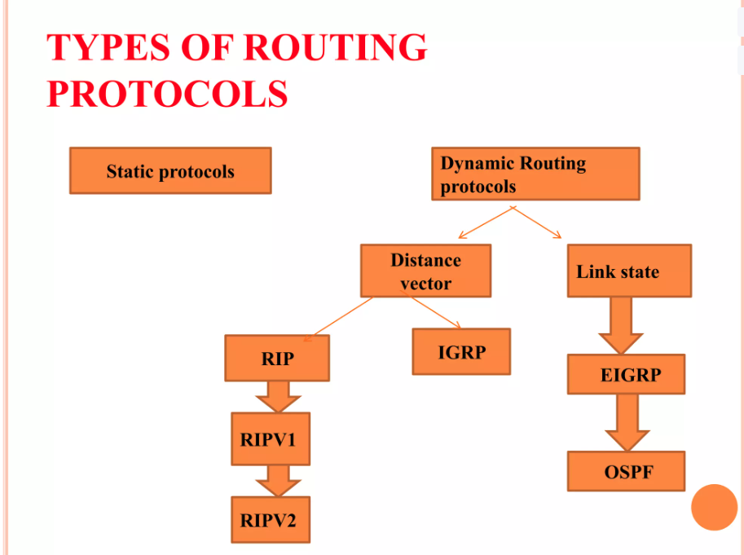

Slide 6
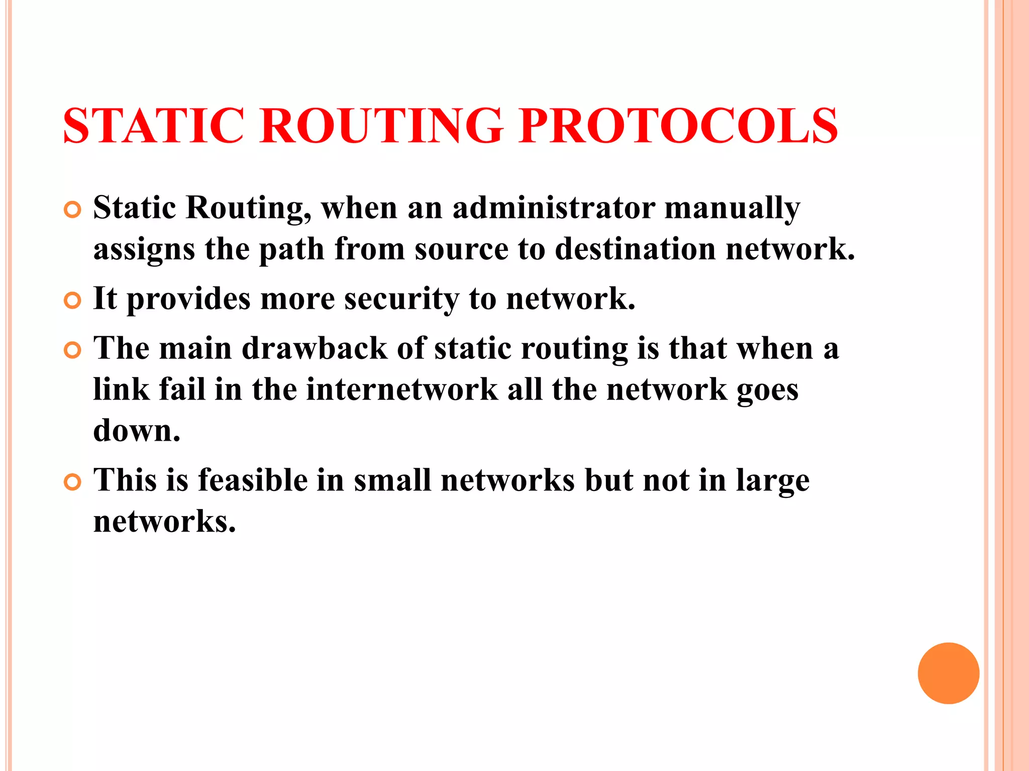

Slide 7
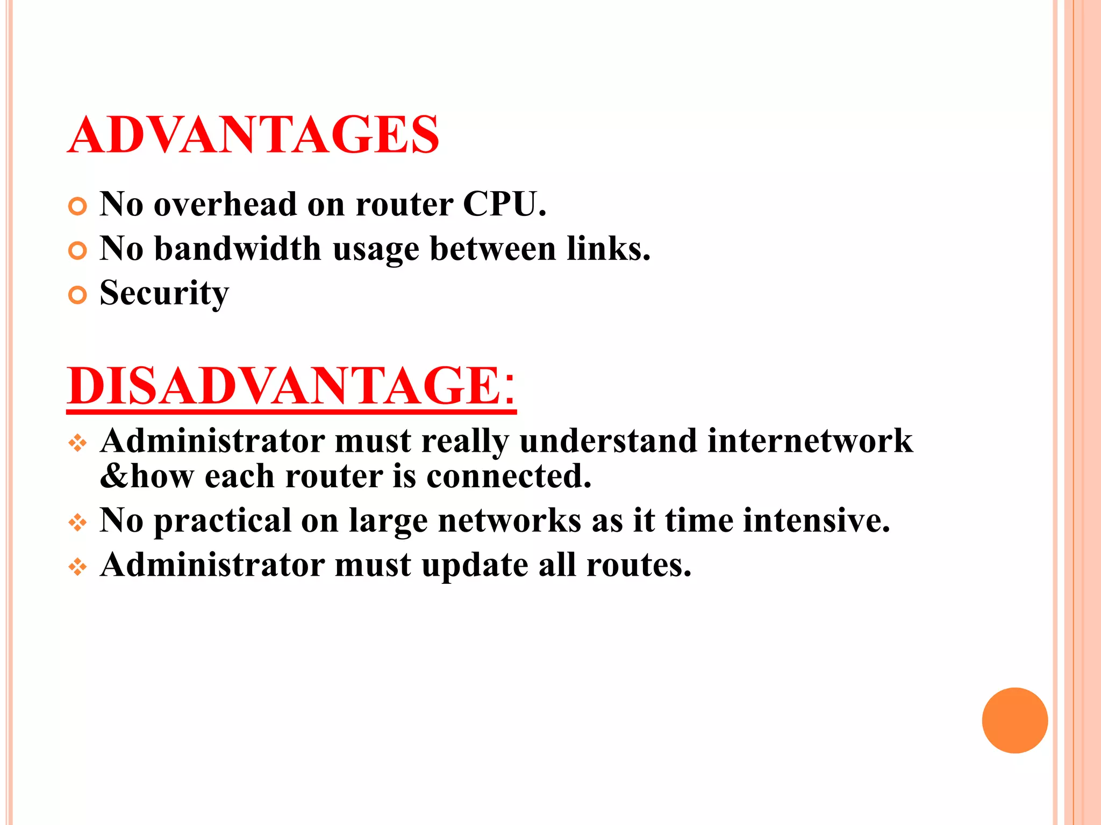

Slide 8
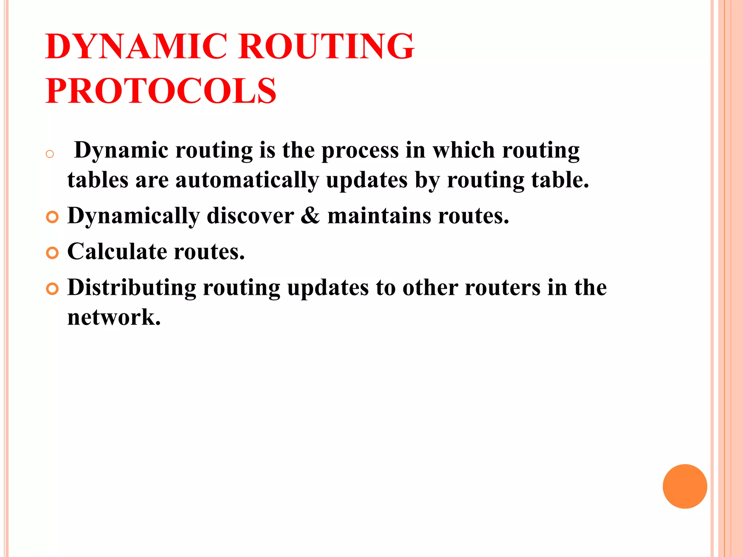

Slide 9
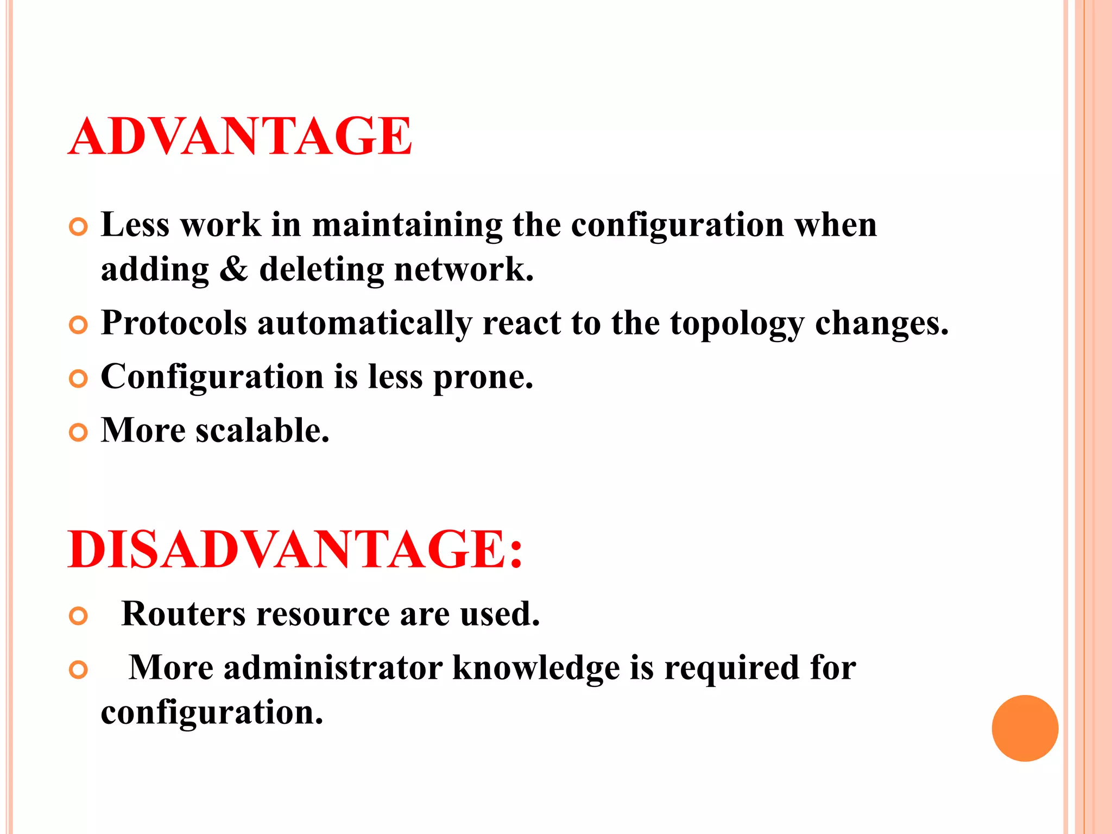

Slide 10
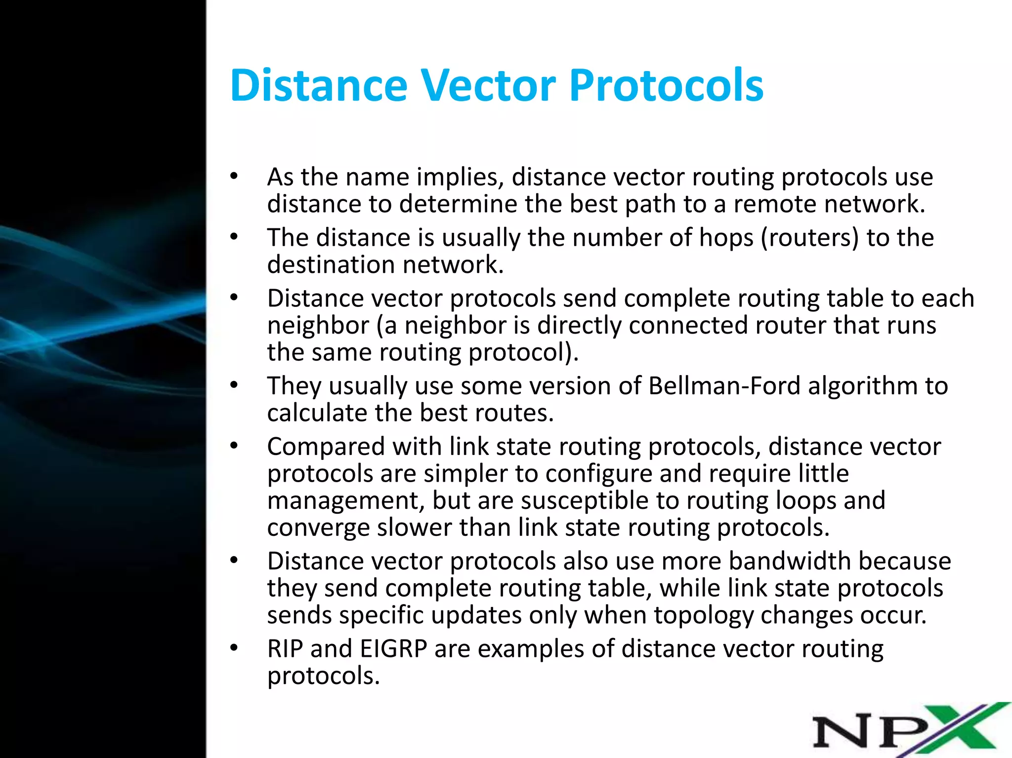

Slide 11
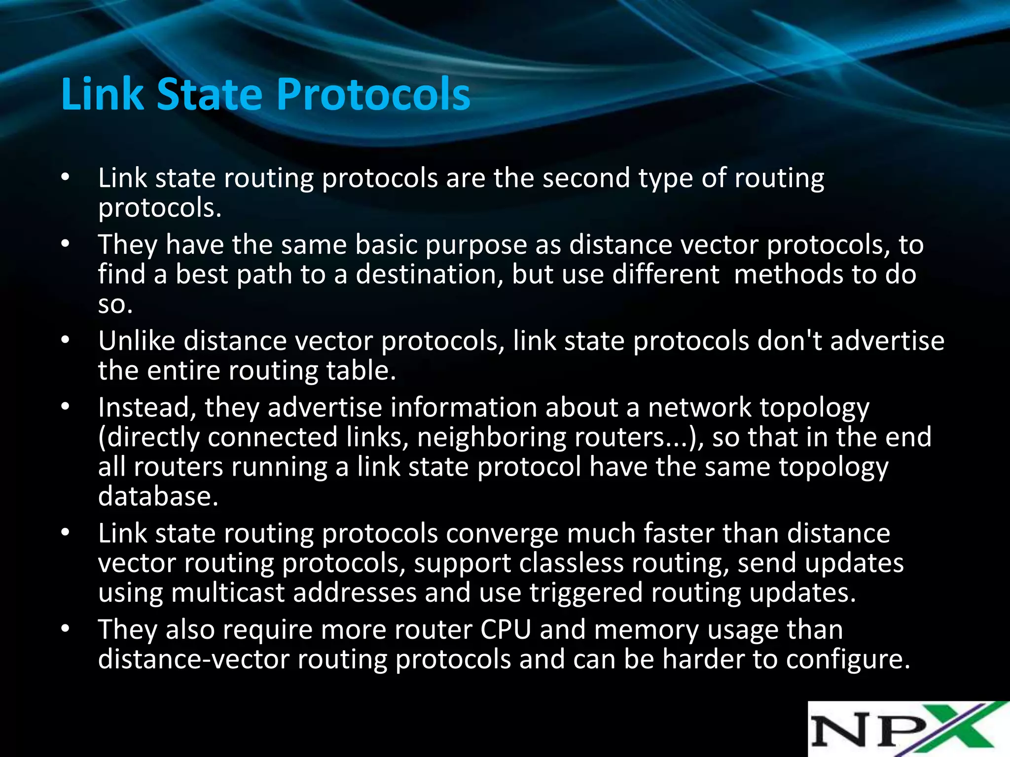

Slide 12
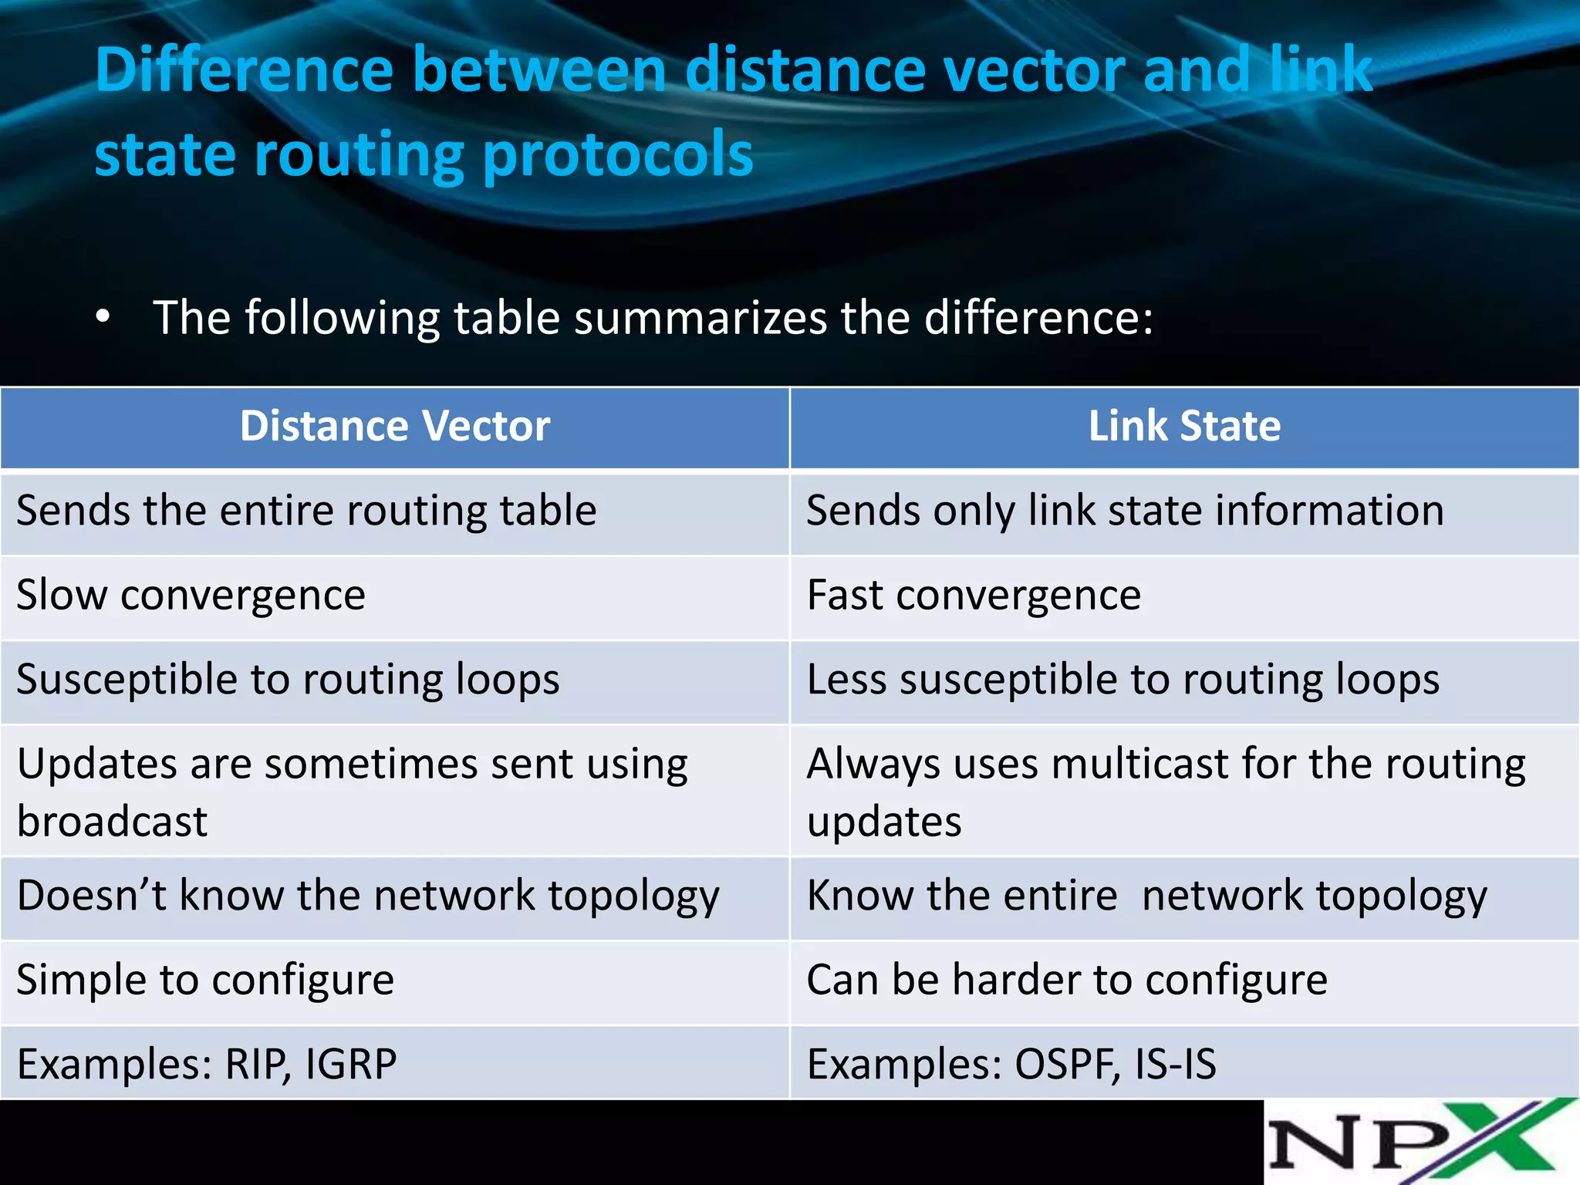

Slide 13
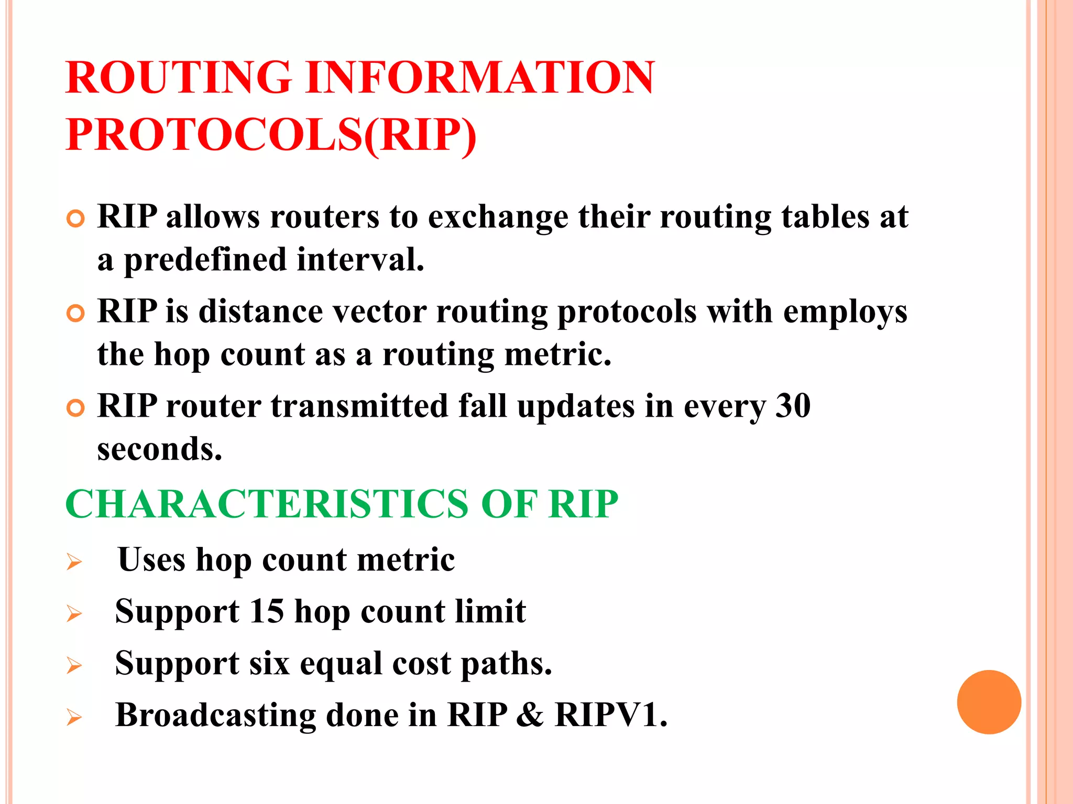

Slide 14
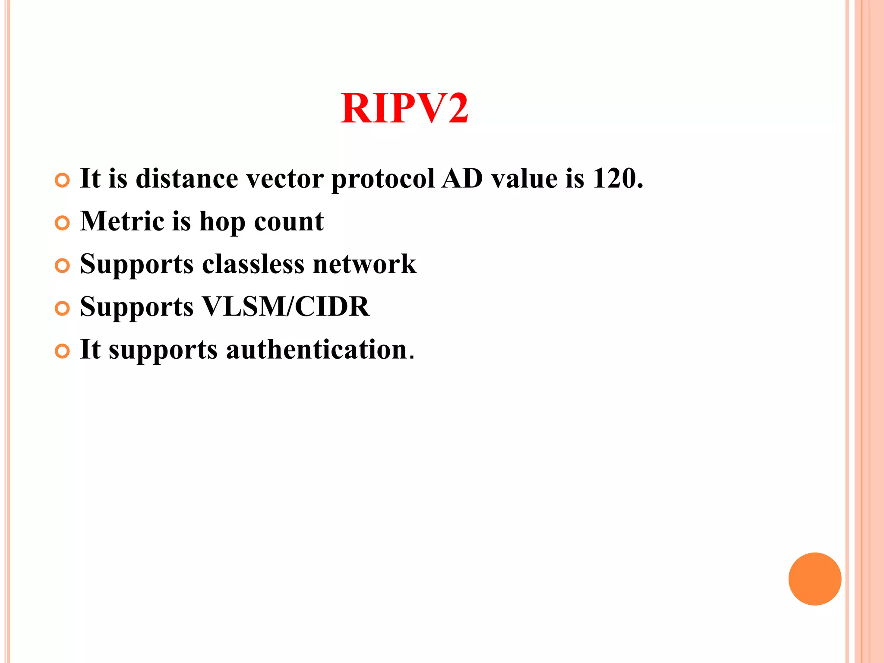

Slide 15
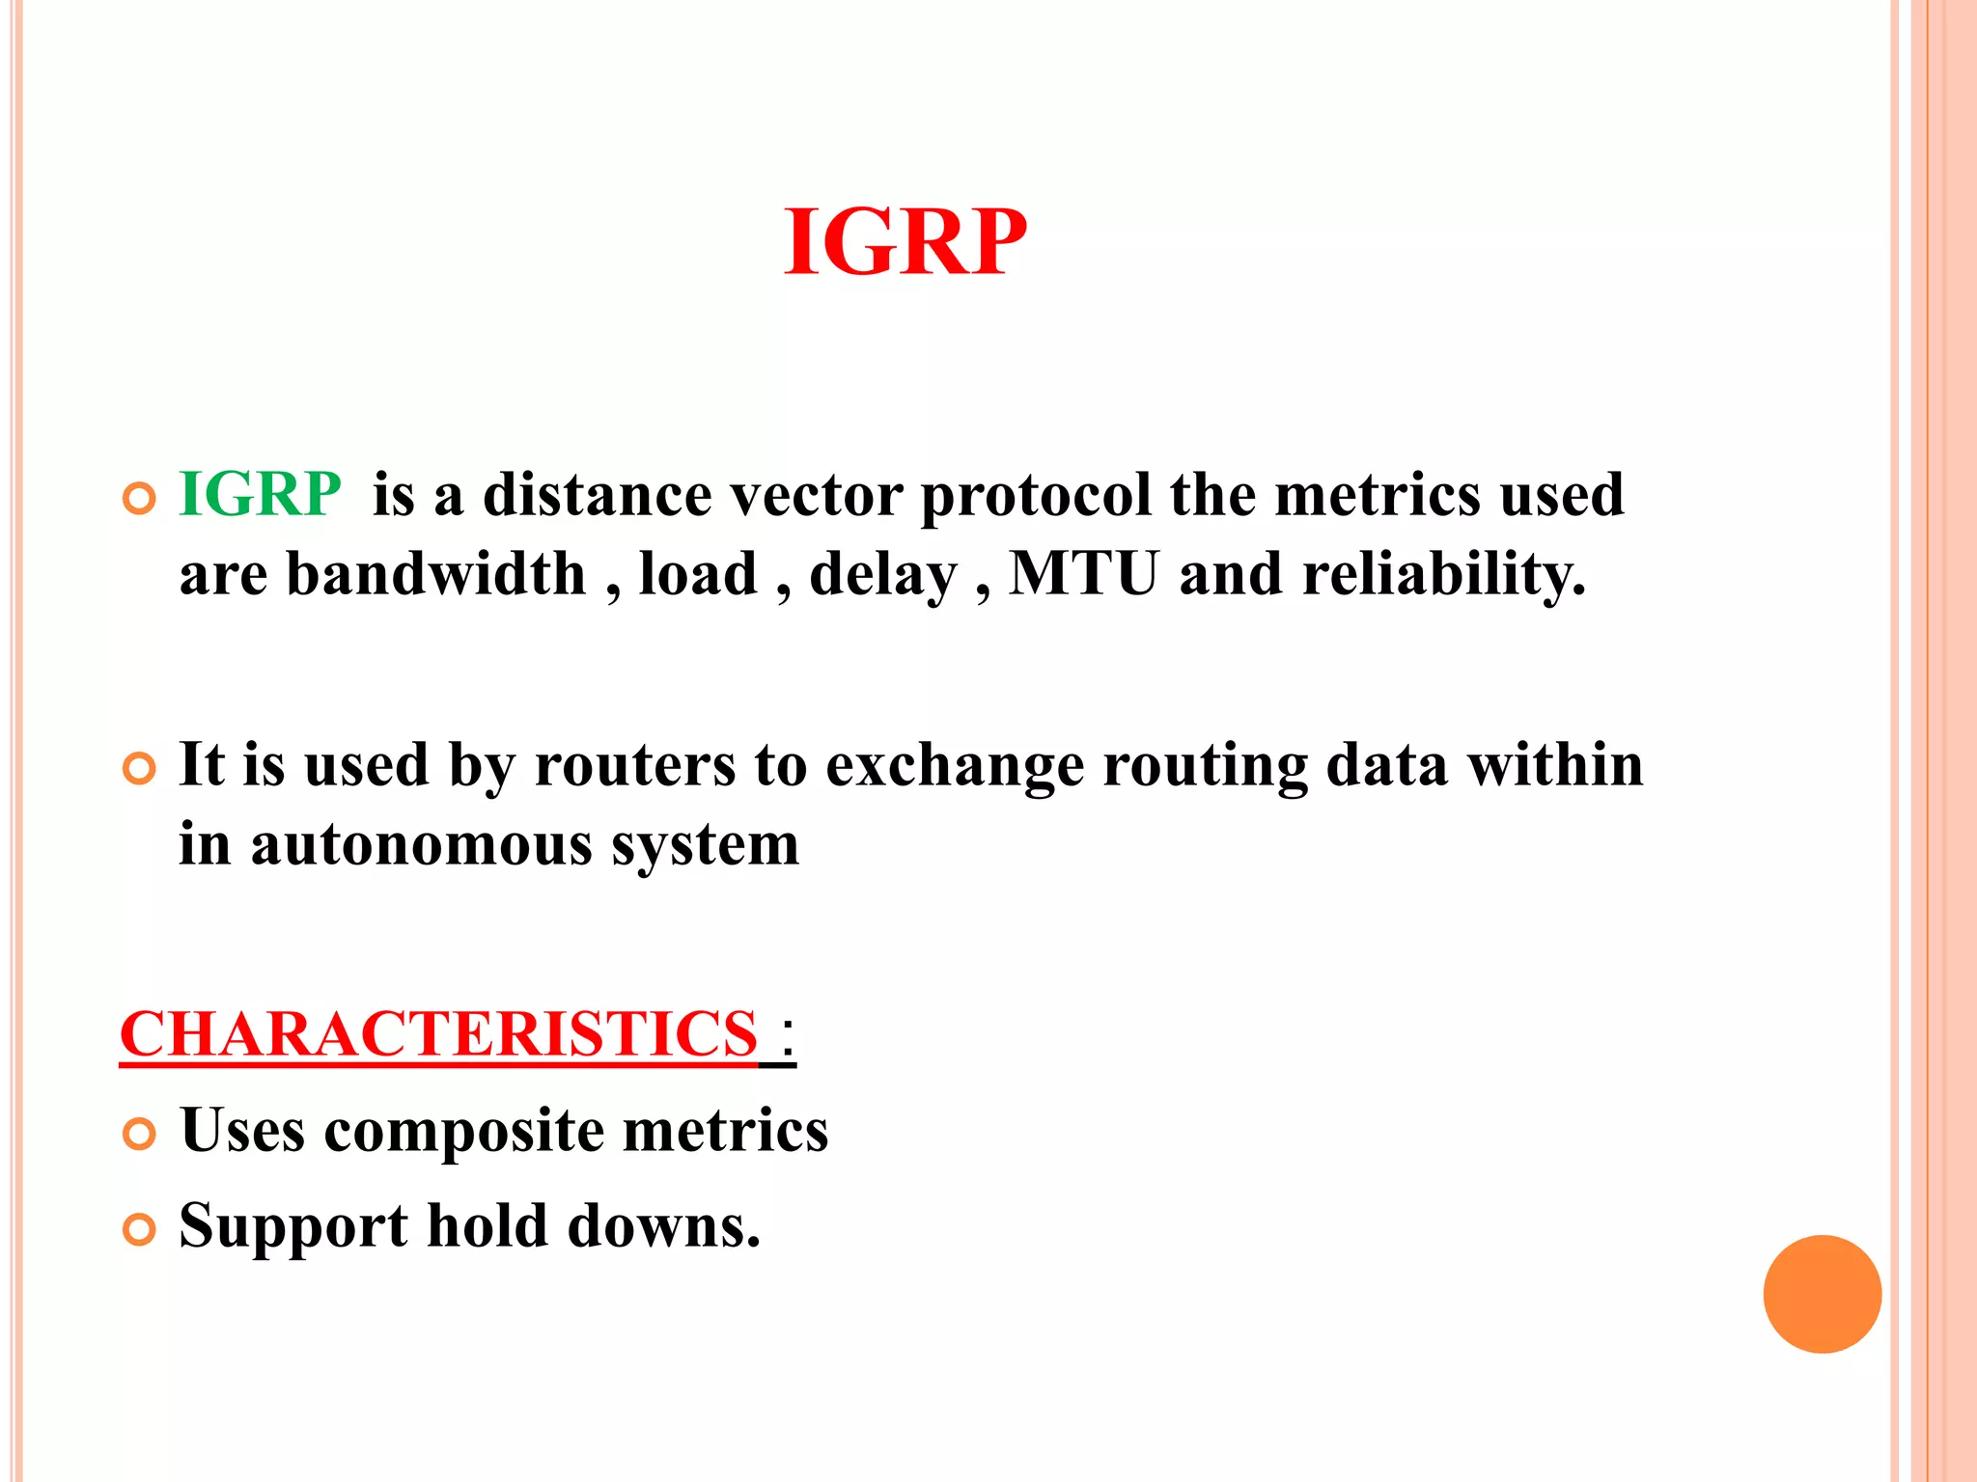

Slide 16
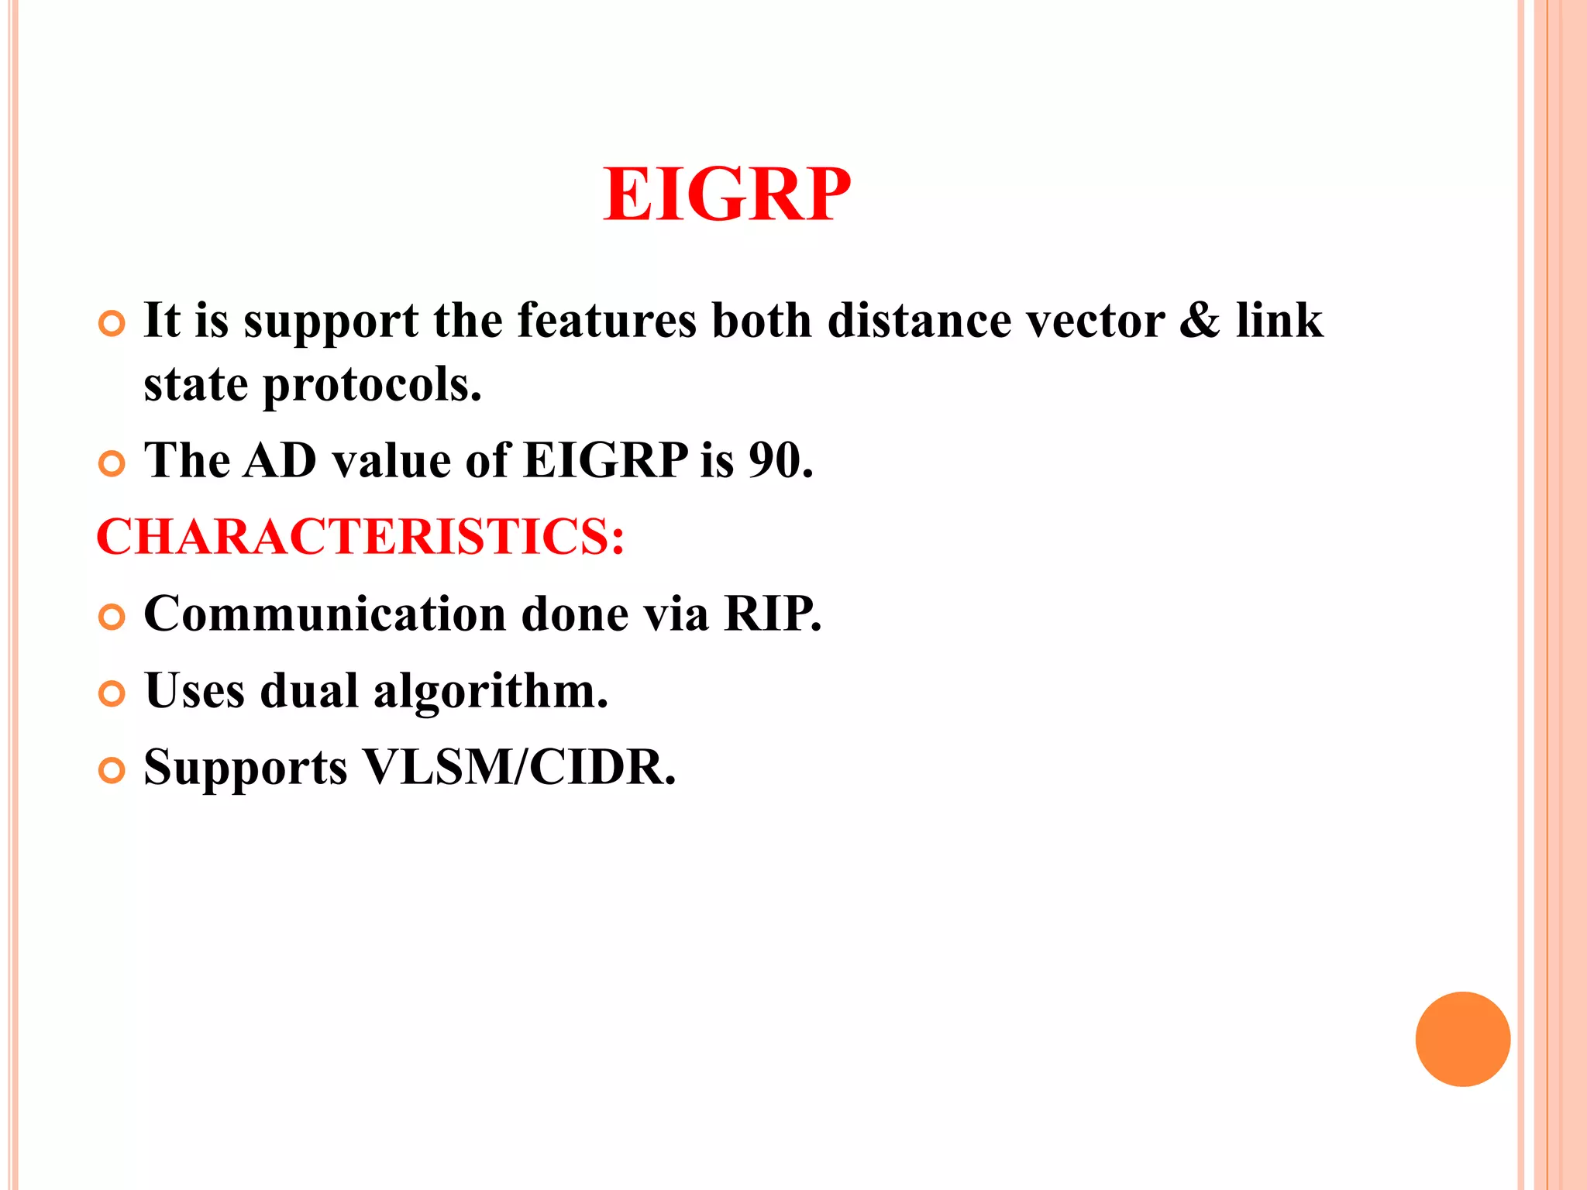

Slide 17
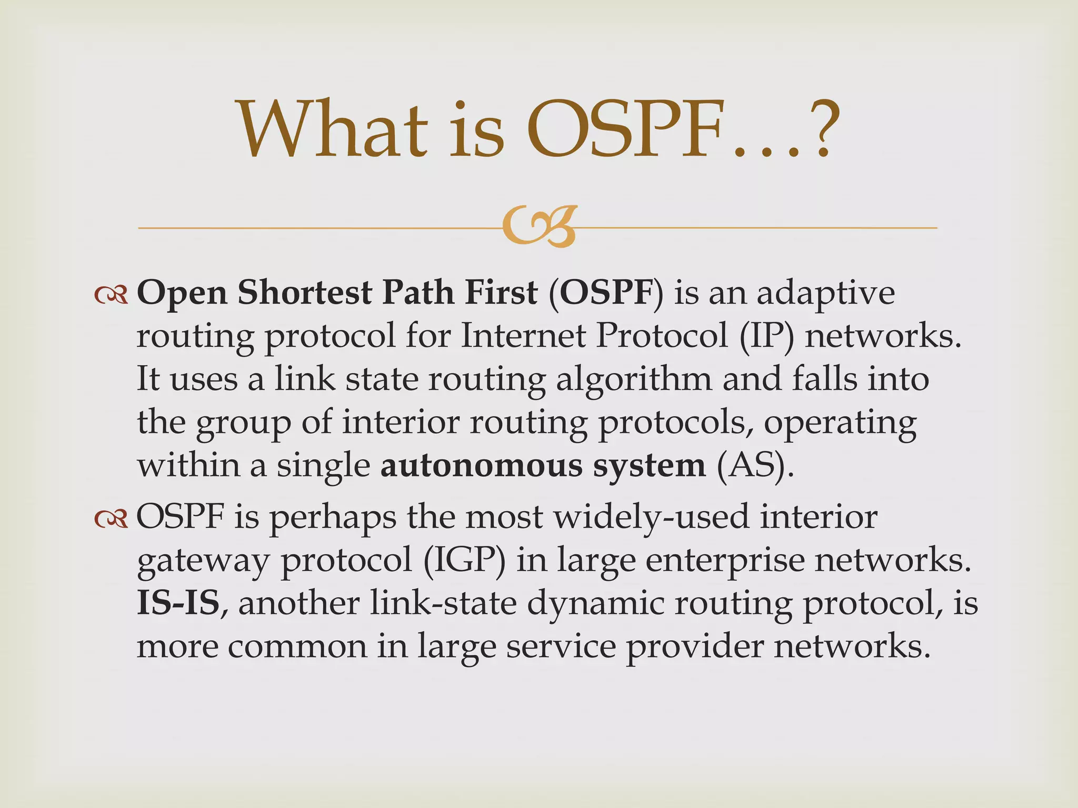

Slide 18
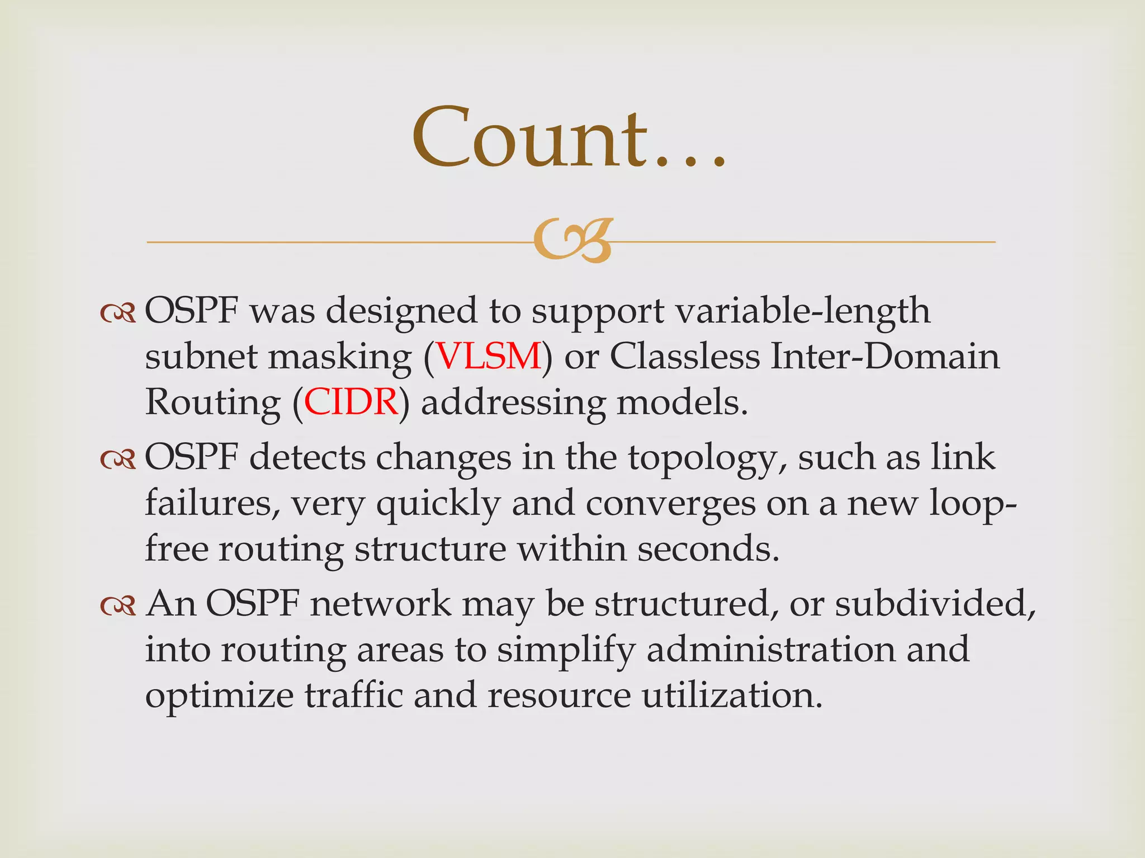

Slide 19
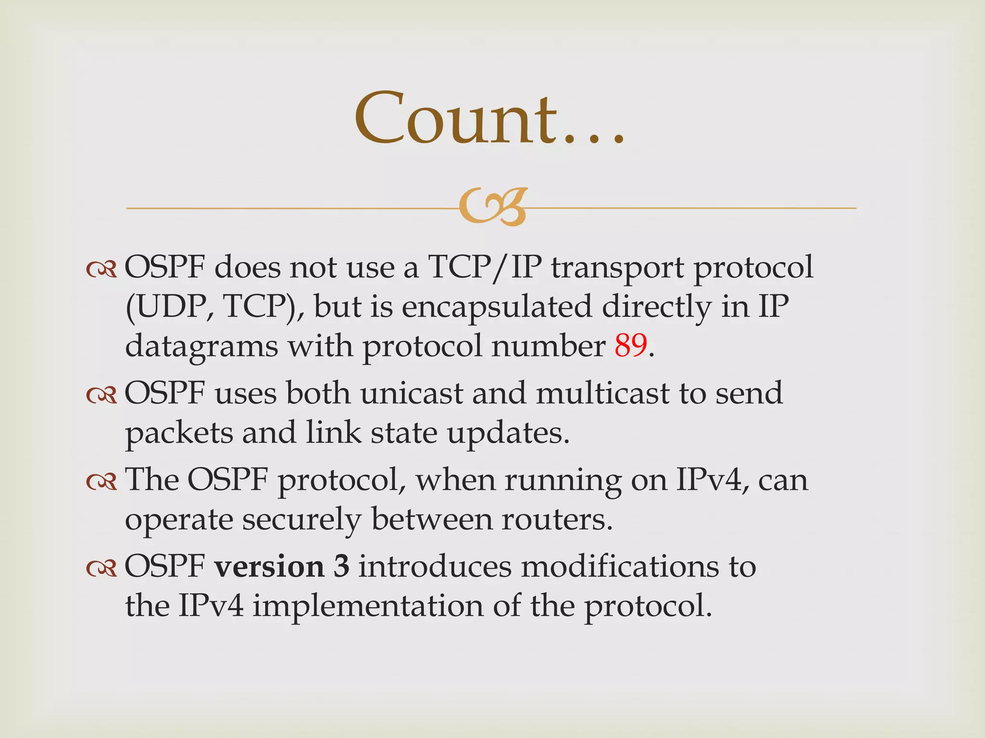

Slide 20
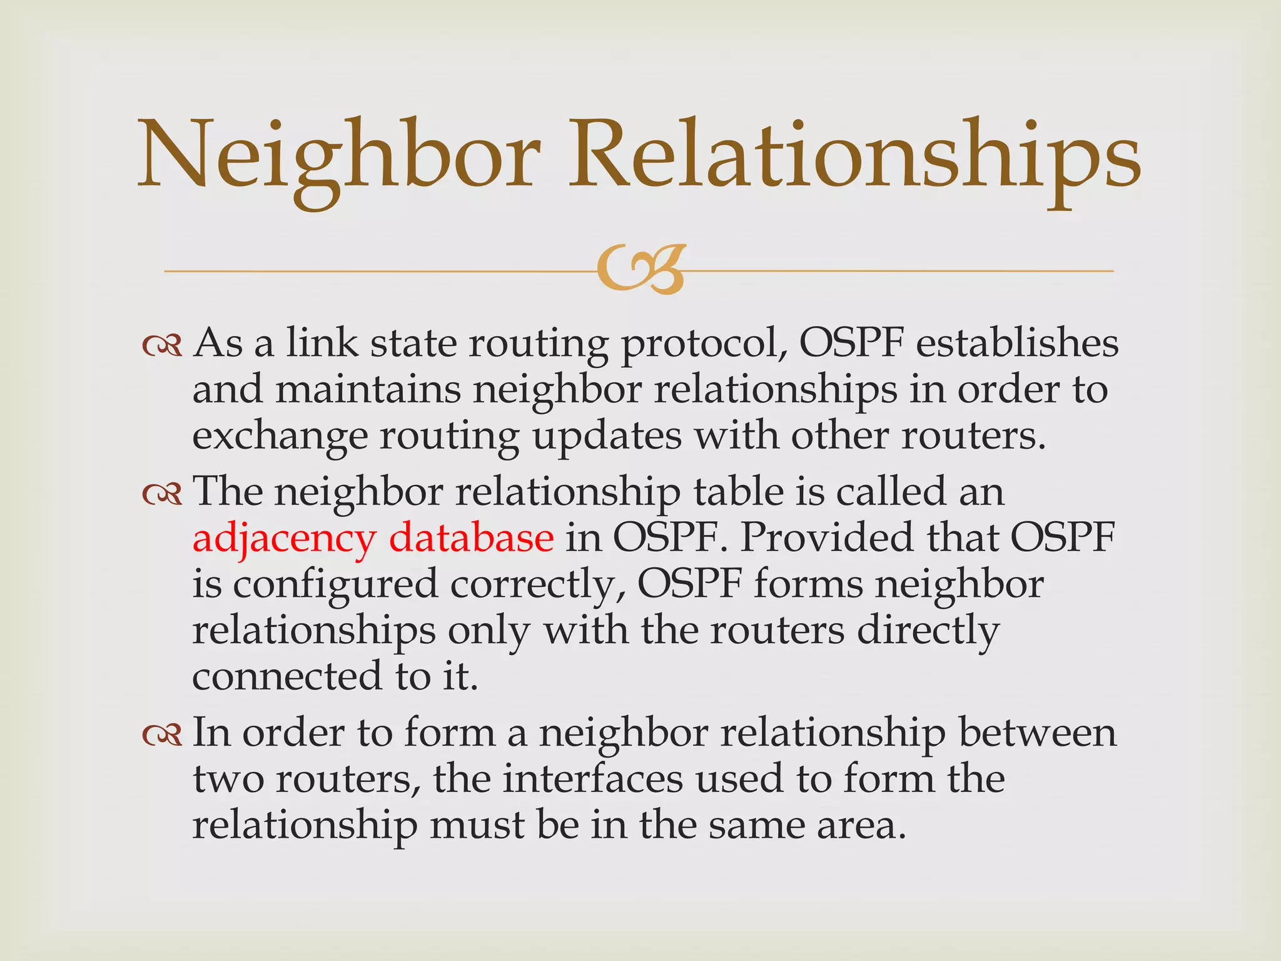

Slide 21
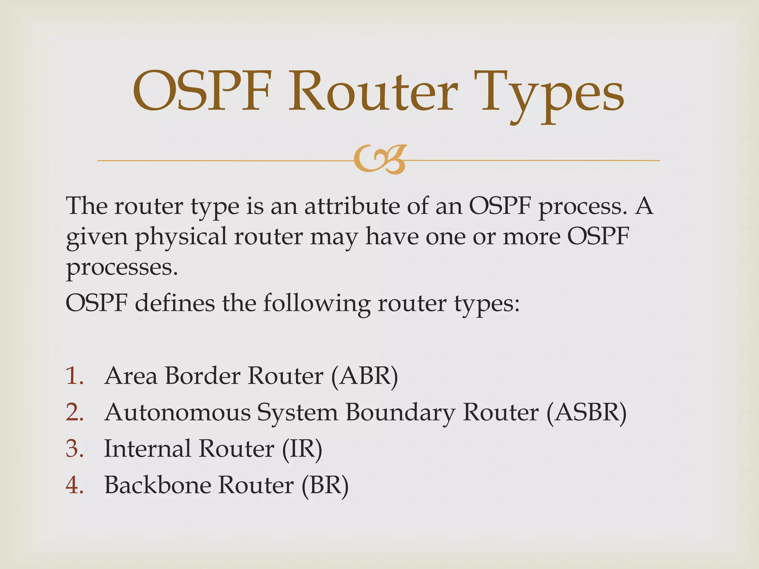

Slide 22
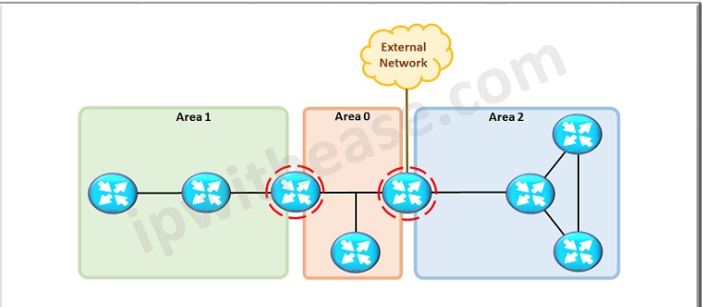
Area Border Router
A router that has OSPF neighbor relationships with devices in multiple OSPF areas. ABRs gather topology information from their connected areas and distribute it to the backbone area.

Slide 23
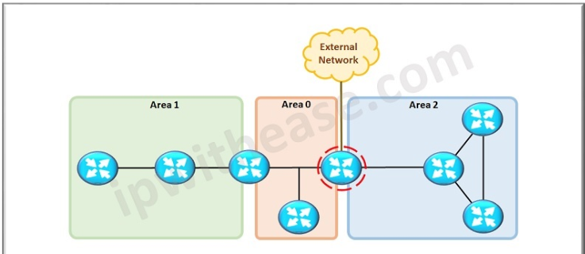
Autonomous System Boundary Router (ASBR)
ASBR is a router that attaches to more than one routing protocol and exchanges routing information between them.

Slide 24
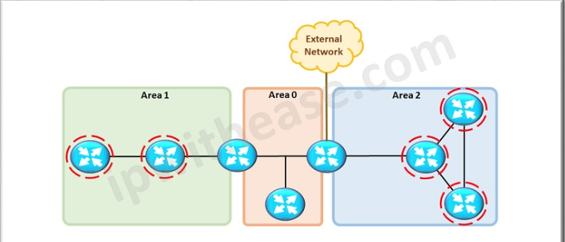
Internal Router
A router that has OSPF neighbor relationships only with devices in the same area.

Slide 25
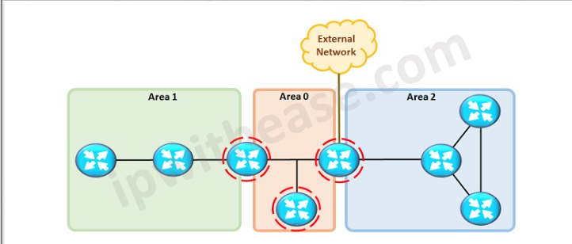
Backbone Router
A backbone router is a router that runs OSPF and has at least one interface connected to the OSPF backbone area.

Slide 26
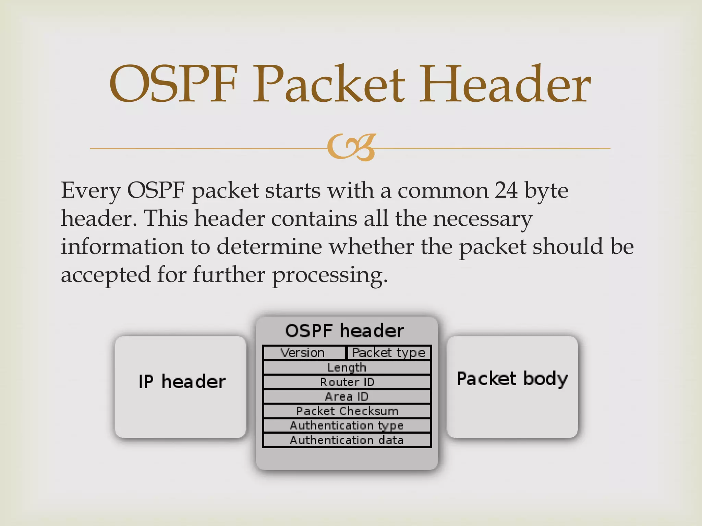

Slide 27
